Slide 1

Cryptocurrency Price Forecasting
Jimmy Nunnally
UMBC
Data 606 Spring 2020
Deliverable 3

Slide 2
Big Data Update!
I was forced to reduce the scope of my project. When attempting transformations on data frames, python would crash. Even some simple cleaning would take minutes per action. I also ran into bandwidth issues from google big query.
Therefore instead of making short term minute forecasts, I am instead making daily forecasts. Answering the question, can I predict the closing price of a day?
Trying to get to a point where if my model predicts tomorrow’s price will be higher, then I buy today. If tomorrow’s price will be lower then I sell.

Slide 3
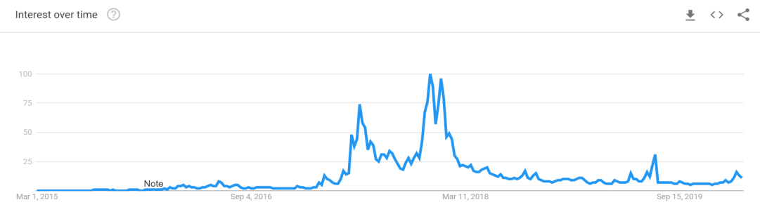
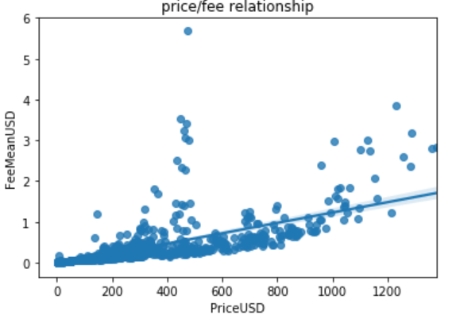
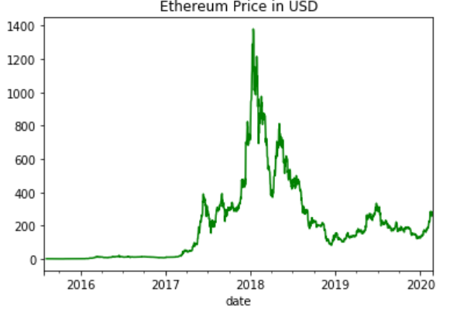
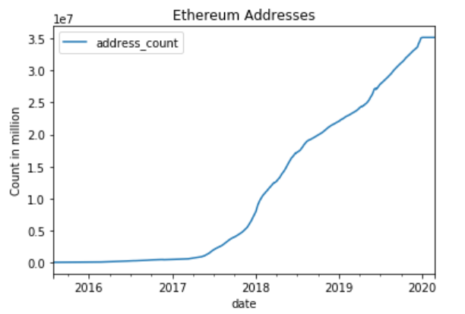
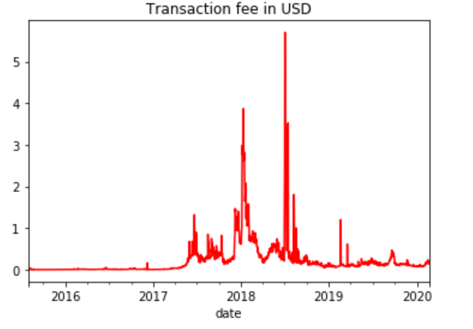
Recap of major trends and variables

Slide 4
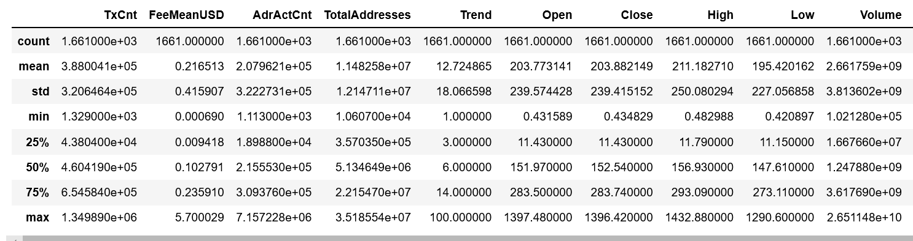
Preparation
The features being utilized were selected from delivery 2’s EDA.
First I needed to merge all of my disparate data sources into one data frame. I did this giving them a common index (date) and merging and setting the data type to float. One of the columns was weekly/rather than daily so I had to interpolate to fill in missing values. Finally, I had to remove rows from before Ethereum started trading to remove nulls

Slide 5
Feature engineering
I utilized stock market theory to develop new features for my model in the form of moving averages, RSI (relative strength index), and Moving Average Convergence Divergence (MACD)
RSI is calculated from moving averages and is often used by financial analysts to show when an asset is overbought or oversold
MACD is a“trend-following momentum indicator that shows the relationship between two moving averages of a security’s price
Notes:
The moving average does a good job of smoothing out rapid price movements

Slide 6
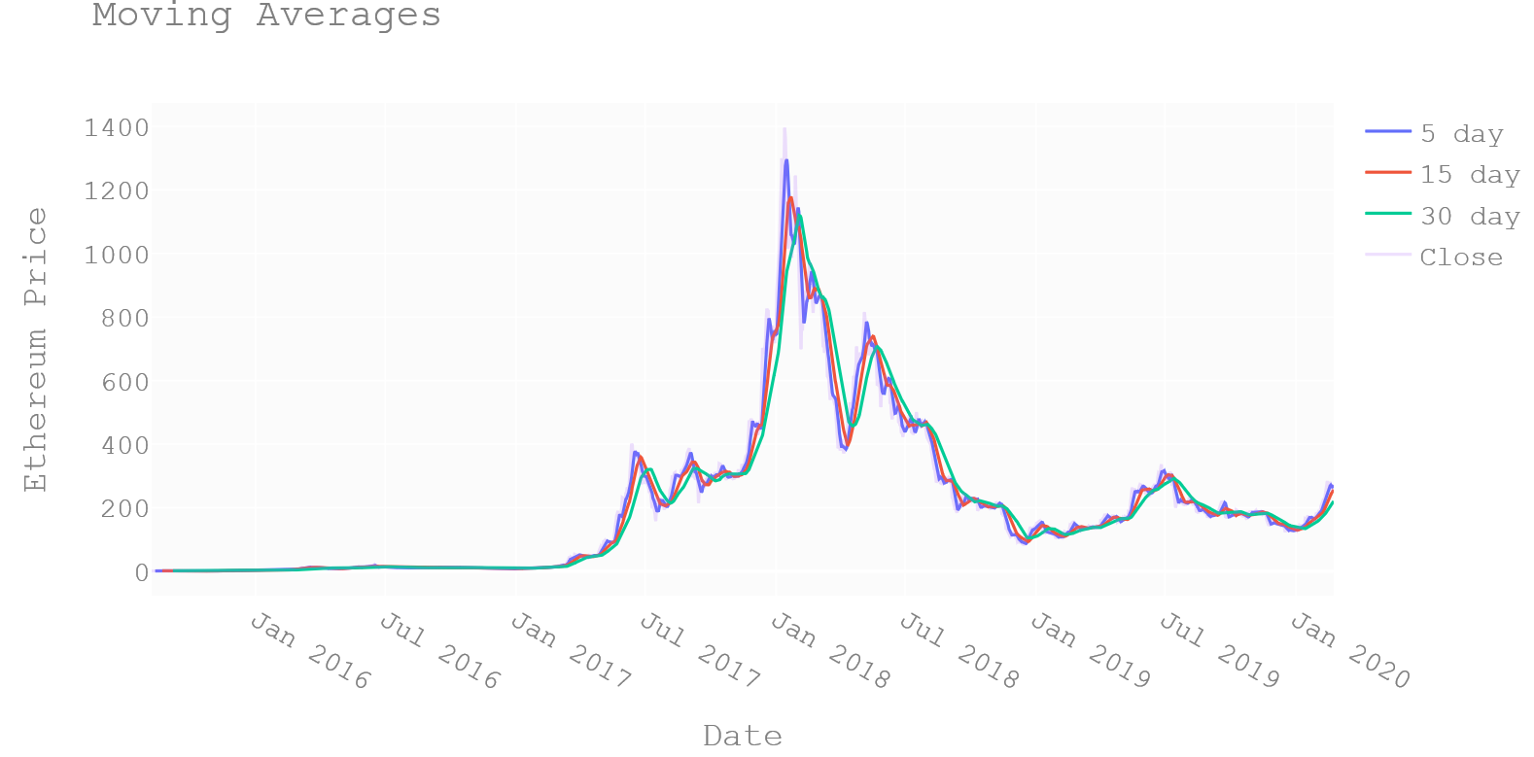
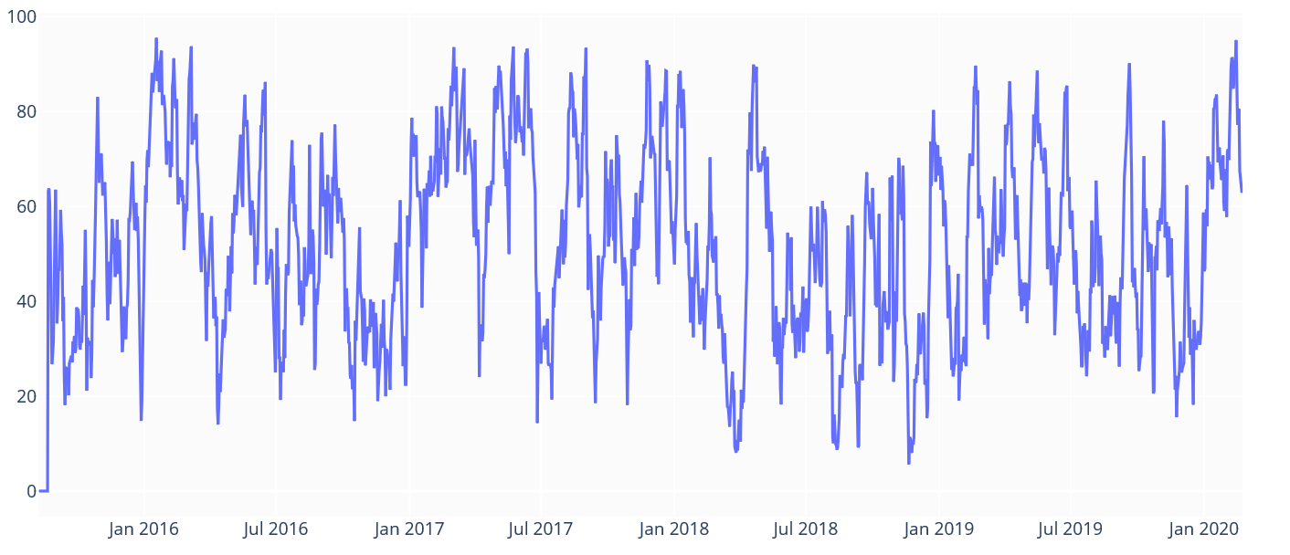
Moving Averages and RSI
Notes:
I actually using RSI by itself for trading

Slide 7
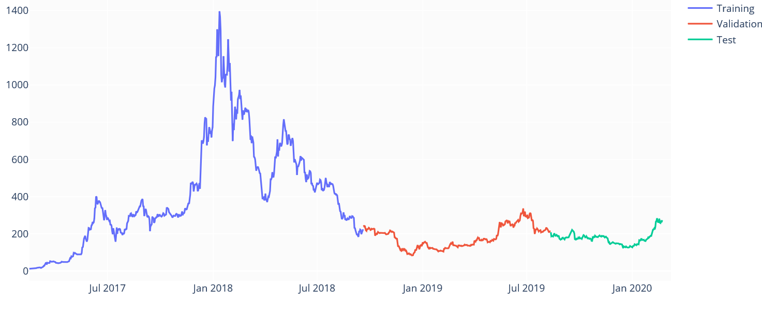
Setting up test/train
Time series prediction
A time series prediction is one where the order of events is important
Pricing of Ethereum is based on historical context
Time Series data cannot be simply is shuffled randomly or ordering would be lost
Need to split data based upon time windows
Notes:
Even if everything else was the same, If I told that a bitcoin was worth $1000 in 2010 you would think I was crazy. Now you would think its cheap.
Not finalized, just make sure it works first. Still working about best way to make window. Intuitively it looks like the first few years of ethereum trading might throw the model off a bit

Slide 8
Extreme gradient tree boosting
Previously identified this to use from “Predicting short-term Bitcoin price fluctuations from buy and sell orders”
Gradient Tree uses a collection of ensemble methods to make a prediction
Extreme gradient includes boosting thus decreases the computational cost of modeling
Work on a time series regression problem
Notes:
This algo is very much in vogue

Slide 9
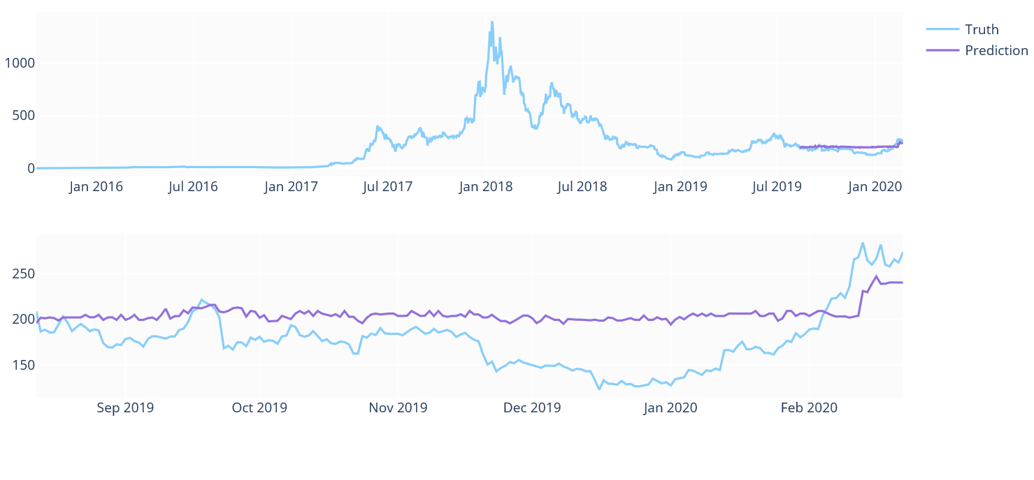
Results
Notes:
Likely underfit, but does appear to be somewhat predictive
Still working out the kinks of time windows
If you view my notebook you can see some of the values

Slide 10
Next steps
Initial model parameters were taken from a tutorial, I will be focusing on fine tuning the model to improve accuracy
Break up additional time windows
My data is now 2 months old (taken in February). I will pull in the most recent data for extra validation
Consider what steps need to be taken to make an actionable trading model. Likely streaming in live day.

Slide 11
Feedback
Notes:
What is the best way to set up time windows for test/train

Slide 12
References
http://francescopochetti.com/pythonic-cross-validation-time-series-pandas-scikit-learn/
https://www.kaggle.com/johanvandenheuvel/lstm-model-of-stockdata
https://www.researchgate.net/publication/323141771_Predicting_short-term_Bitcoin_price_fluctuations_from_buy_and_sell_orders?enrichId=rgreq-c5c3e2551eac9650e731da8639be436f-XXX&enrichSource=Y292ZXJQYWdlOzMyMzE0MTc3MTtBUzo1OTgzMTQwMTM3MDgyODhAMTUxOTY2MDU4NTI4OQ%3D%3D&el=1_x_3&_esc=publicationCoverPdf

